Slide 1
Secure Data Hiding in Image Using Steganography
CAPSTONE PROJECT
Presented By : VAIBHAV RAM RATHOD
Student Name : VAIBHAV RAM RATHOD
College Name : PROF. RAM MEGHE INSTITUTE OF TECHNOLOGY & RESEARCH, BADNERA AMRAVATI
Department : INFORMATION TECHNOLOGY

Slide 2
OUTLINE
Problem Statement
Technology used
Wow factor
End users
Result
Conclusion
Git-hub Link
Future scope

Slide 3
Problem Statement
With increasing digital communication, securing sensitive data is a major challenge. Traditional encryption methods attract attention, making hidden data vulnerable. Steganography provides a solution by concealing secret information inside images, ensuring confidentiality without raising suspicion.

Slide 4
Technology used
Programming Language: Python
Operating System: Windows
Libraries Used: OpenCV, Tkinter (for GUI), Cryptography

Slide 5
Wow factors
The project enables hiding secret data inside an image without altering its visible appearance.
Enhances security as only authorized users with a decryption key can retrieve the hidden message.
Can be applied for secure communication, watermarking, and digital forensics.

Slide 6
End users
Cybersecurity Professionals
Government Agencies
Digital Forensics Experts
Private Organizations & Businesses
General Users for Personal Data Protection

Slide 7
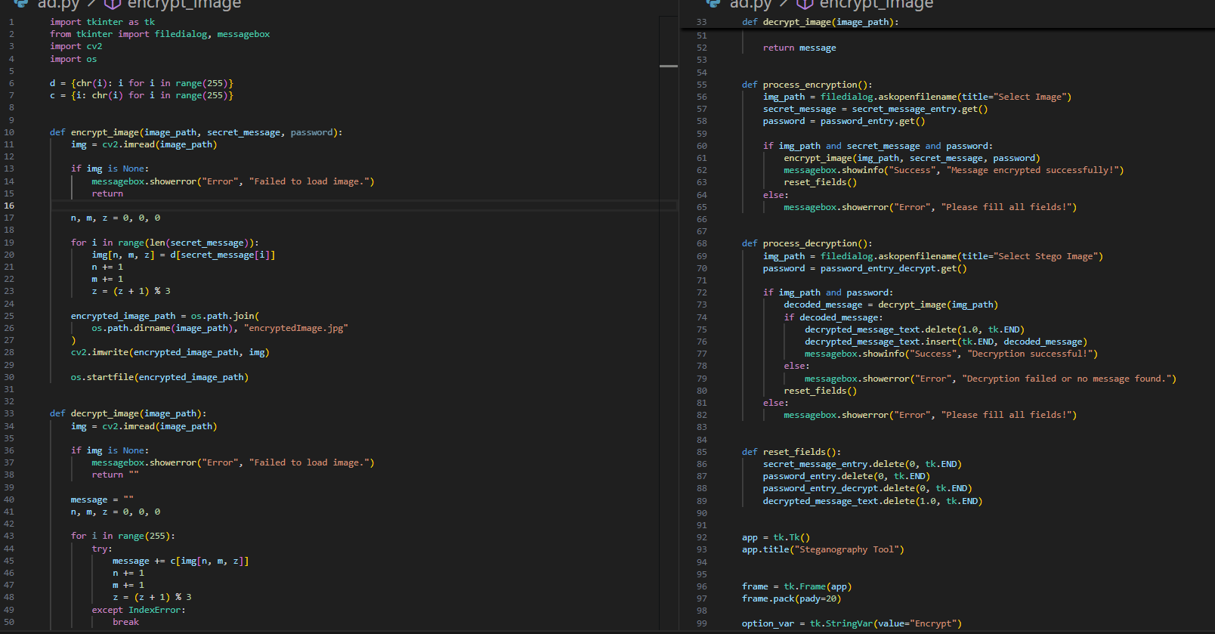
Results

Slide 8
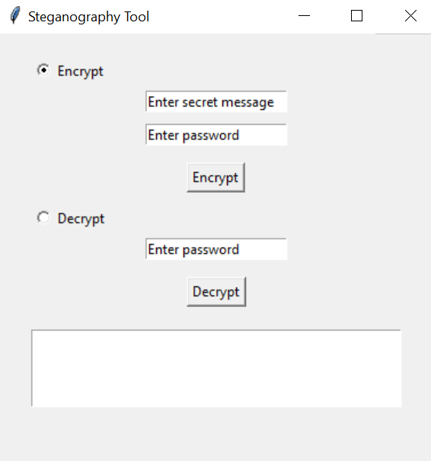
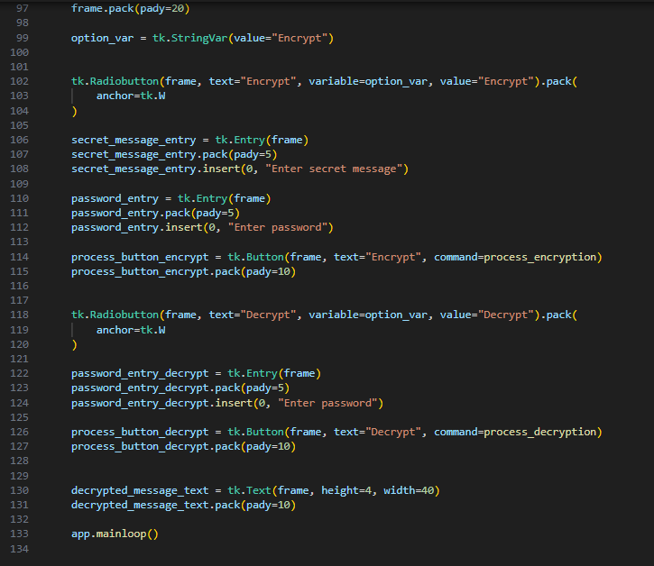
Results

Slide 9
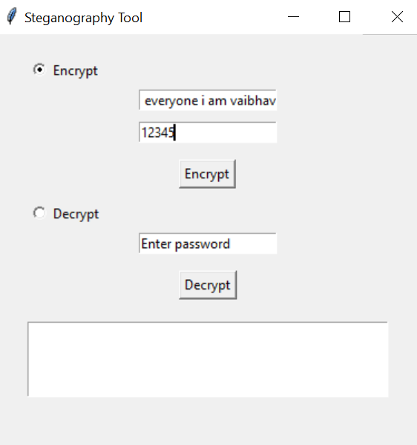
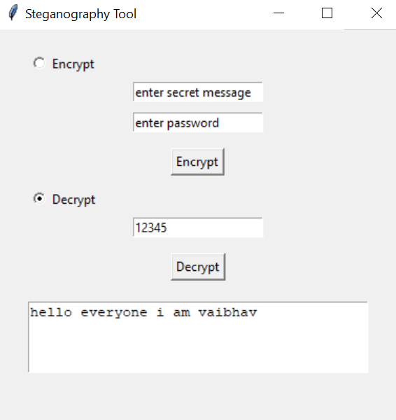
Results

Slide 10
Conclusion
The project provides a secure and efficient method for data concealment using image steganography. By leveraging Python and relevant libraries, we ensure ease of implementation and effectiveness in protecting sensitive information.

Slide 11
GitHub Link
https://github.com/VaIBHaV-Rathod1/project_Steganography.git

Slide 12
Future scope(optional)
AI-based Steganography: Implementing deep learning for smarter data hiding and detection.
Multi-layer Encryption: Enhancing security by integrating encryption with steganography.
Cross-Platform Compatibility: Extending support for mobile and web applications.
Robust Steganalysis Prevention: Making detection of hidden data even harder.

Slide 13
THANK YOU

